Slide 1


Chapter 8
Managing Memory for a Virtual Machine
Virtualization Essentials

Slide 2
Chapter 8 Objectives
Understand how memory is virtualized in a virtual machine
Understand the memory configuration options
Investigate memory tuning practices
Examine some memory optimizations
2

Slide 3
Virtualizing Memory
Memory is storage (just really fast storage)
Memory is also workspace for operating systems and programs
Caching data
Scratchpad
Virtual machines use memory in the same way
The hypervisor maps virtual memory blocks to the physical memory and uses address translation tables to keep track
These tables are part of the hypervisor’s overhead
3

Slide 4
Memory Pages
Memory blocks are also called pages
Paging is when pages move from memory to disk
Because paging involves disk I/O, it is slow and to be avoided
Memory is the resource most likely to be scarce
4

Slide 5
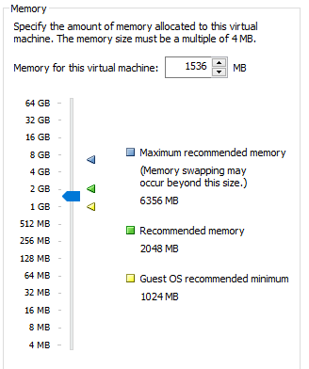
Memory Configuration
Memory can only be added or subtracted
Addition can be hot-added depending on the operating system
Subtraction requires a reboot
5

Slide 6
Memory Overhead
The hypervisor requires some memory for its own needs as well as for memory mapping tables
That overhead has shrunk dramatically as technology had improved and denser memory has become available
Other VM memory optimizations help overall memory consumption
6

Slide 7
Memory Ballooning
Ballooning reclaims unused memory from a virtual machine when it is needed somewhere else
Older memory pages get flushed to disk
Only occurs when there is memory contention
This is one way hypervisors can facilitate memory overcommit
7

Slide 8
Memory Overcommit
Memory overcommit allows virtual machines to be allocated more memory than is in the physical virtualization server
When used correctly, can save significant costs
8

Slide 9
Page Sharing
Duplicate pages in different VMs are mapped to the same page in physical memory
Works between different virtual machines, but also within a virtual machine that has duplicate pages
Can reclaim 10 to > 40% of physical memory
Also facilitates memory cost savings
Similar to storage deduplication
9

Slide 10
Chapter 8 Summary
Memory is usually the key resource for effective virtualization
There are many memory optimizations that make virtualization more effective
Memory overcommit
Memory ballooning
Transparent page sharing
Memory compression
Memory optimizations help drive higher consolidation ratios and lower costs
10

